Slide 1



walmart_feature
View in Power BI
Last data refresh:
5/28/2021 11:30:25 PM UTC
Downloaded at:
5/29/2021 1:01:29 AM UTC

Slide 2
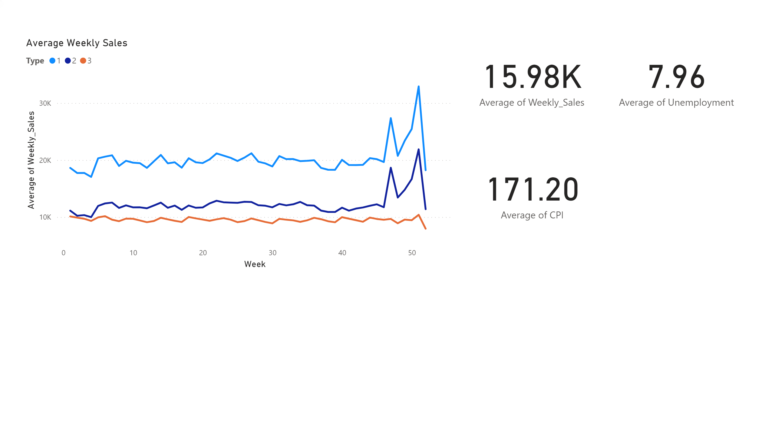
Weekly Sales
Notes:
card
No alt text provided.
card
No alt text provided.
card
No alt text provided.
Average Weekly Sales
No alt text provided.

Slide 3
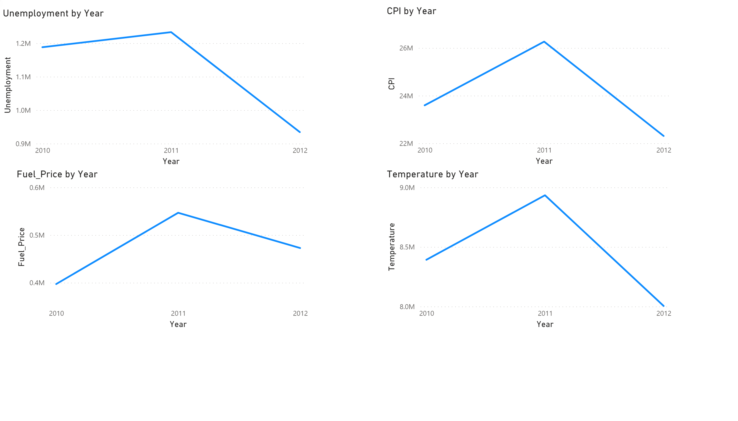
Relationship with Unemployment
Notes:
lineChart
No alt text provided.
lineChart
No alt text provided.
lineChart
No alt text provided.
lineChart
No alt text provided.

